Slide 1
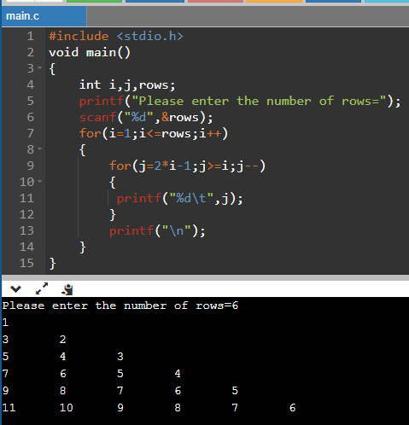
A Number Pattern

Slide 2
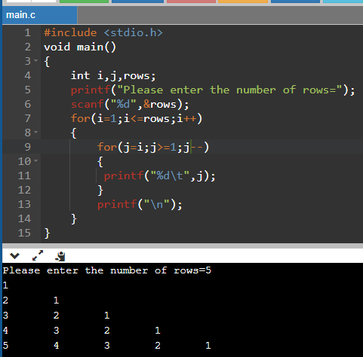
An Another Number Pattern

Slide 3
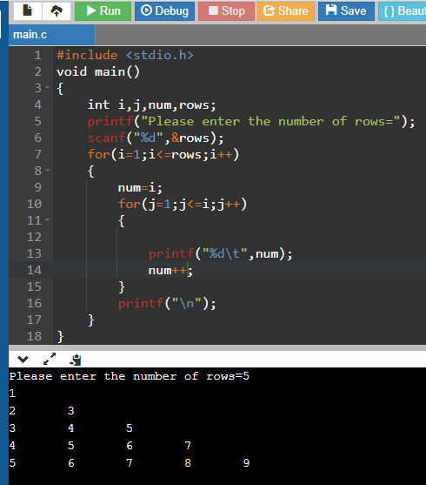
An Another Number Pattern

Slide 4
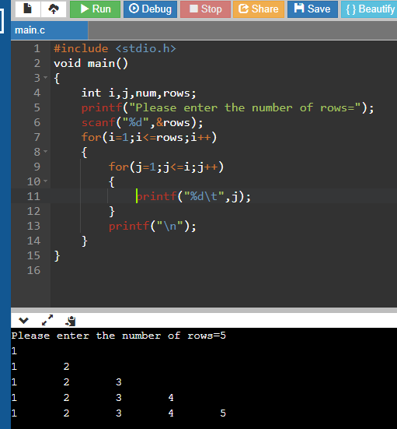
An Another Number Pattern

Slide 5
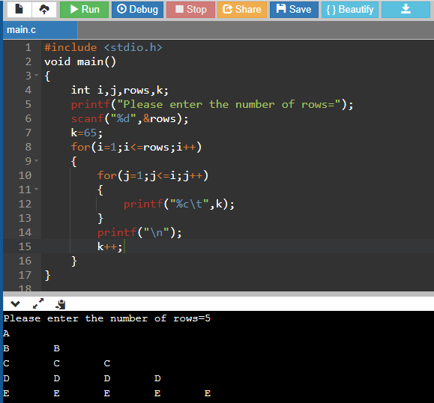
An Alphabet Number Pattern

